Slide 2
Simulated Bragg peaks

Slide 3
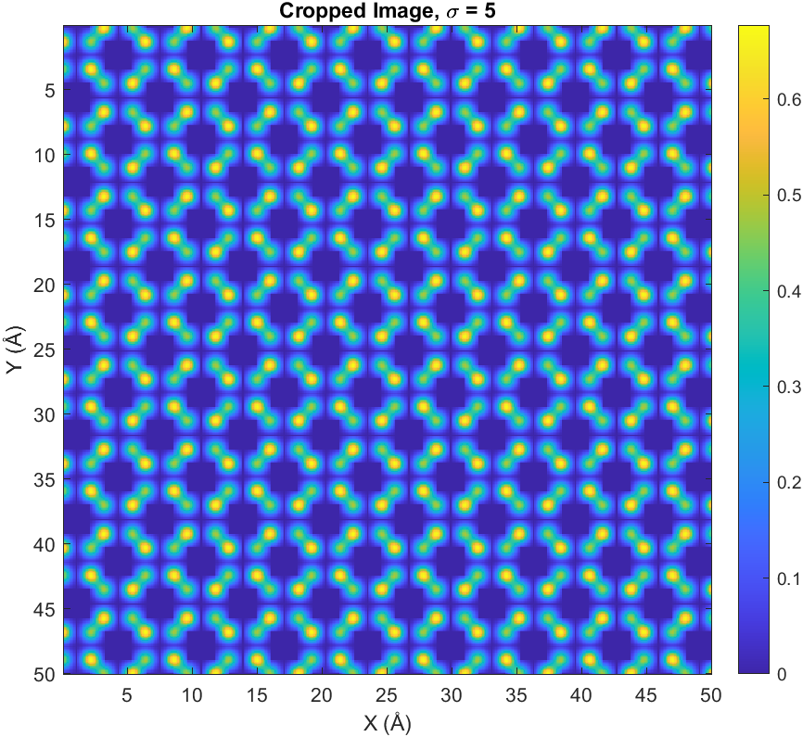
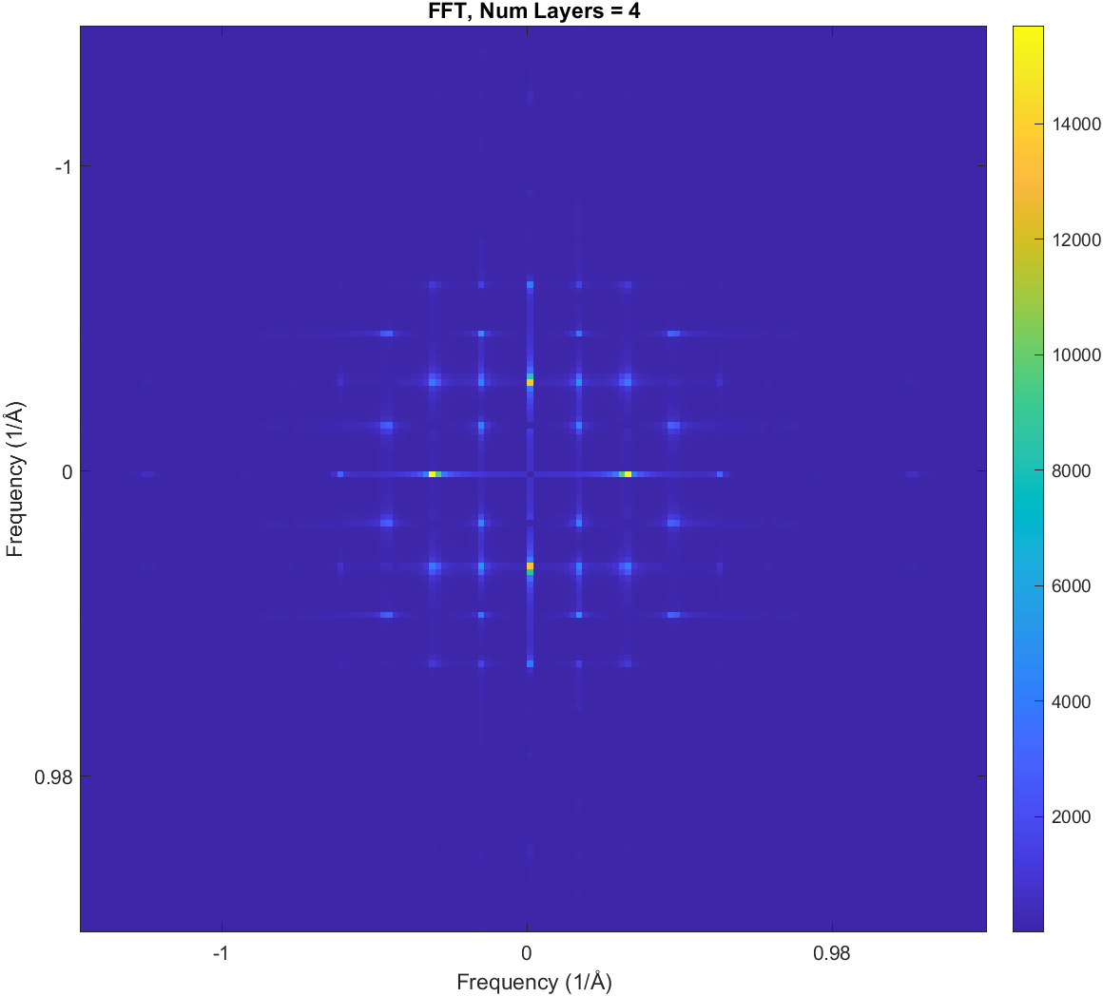
Num_layer=4, sigma= 5

Slide 4
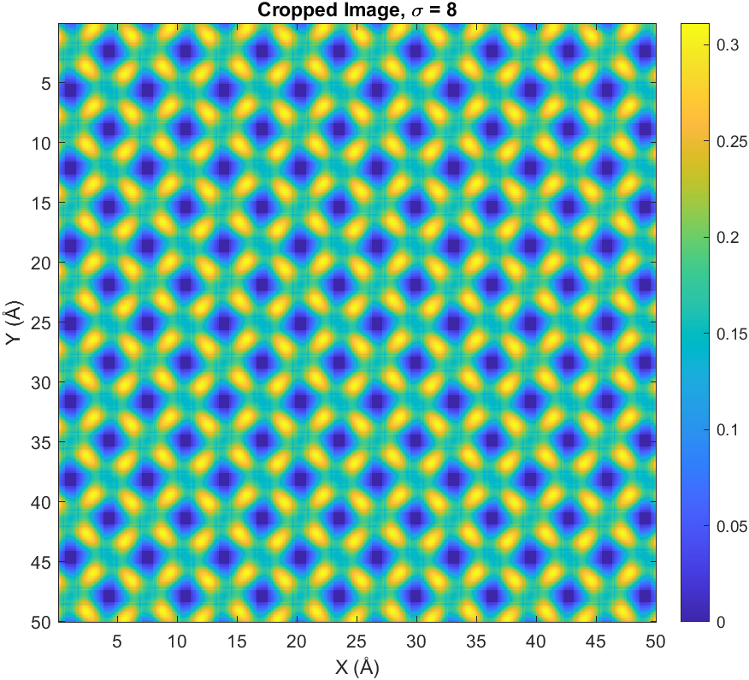
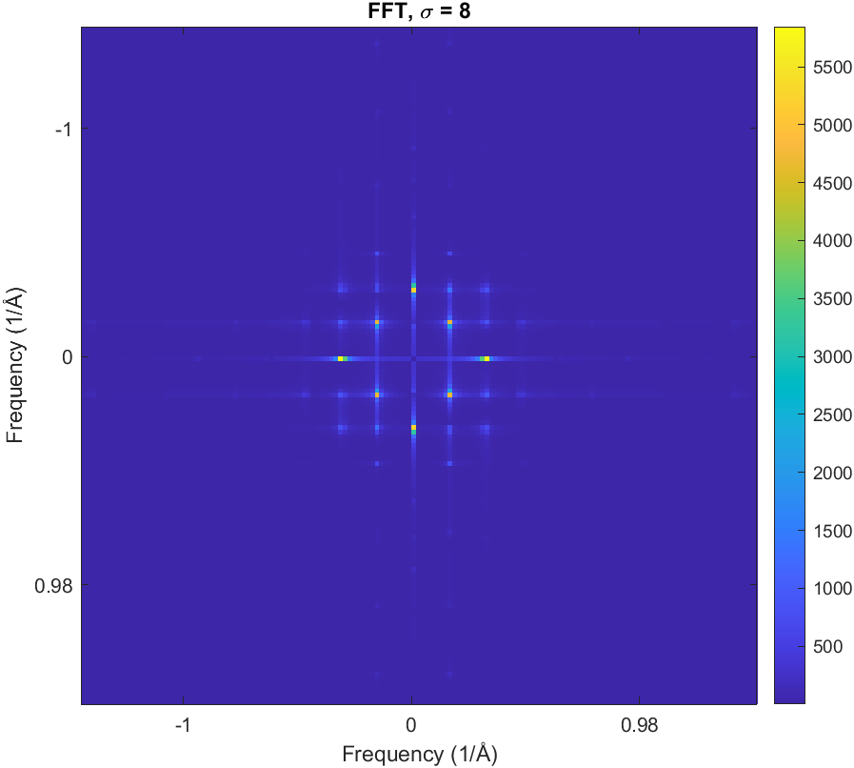
Num_layer=4, sigma= 8

Slide 5
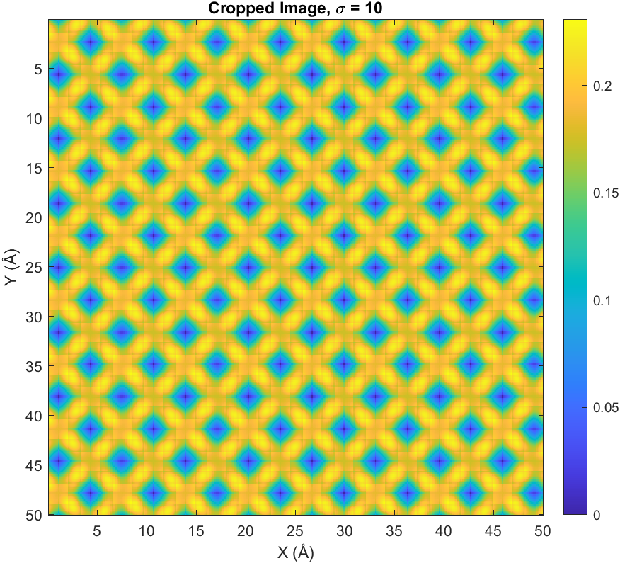

Num_layer=4, sigma= 10

Slide 6
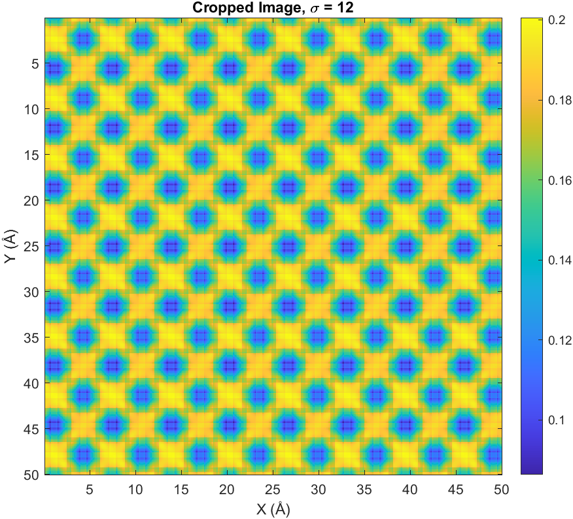

Num_layer=4, sigma= 12

Slide 7
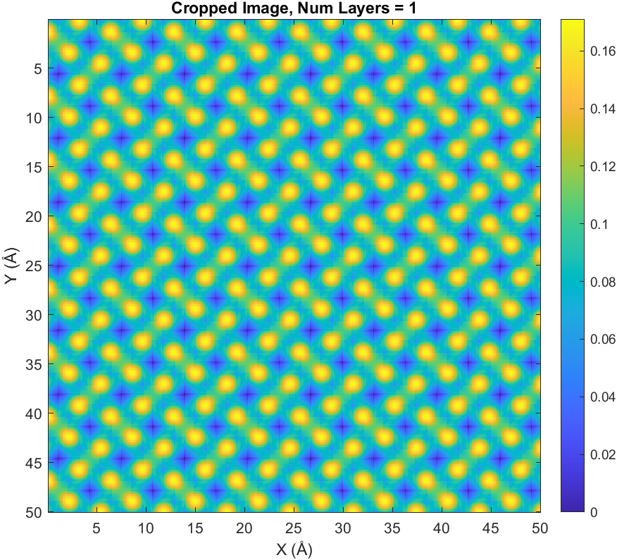

Num_layer=1, sigma= 5

Slide 8
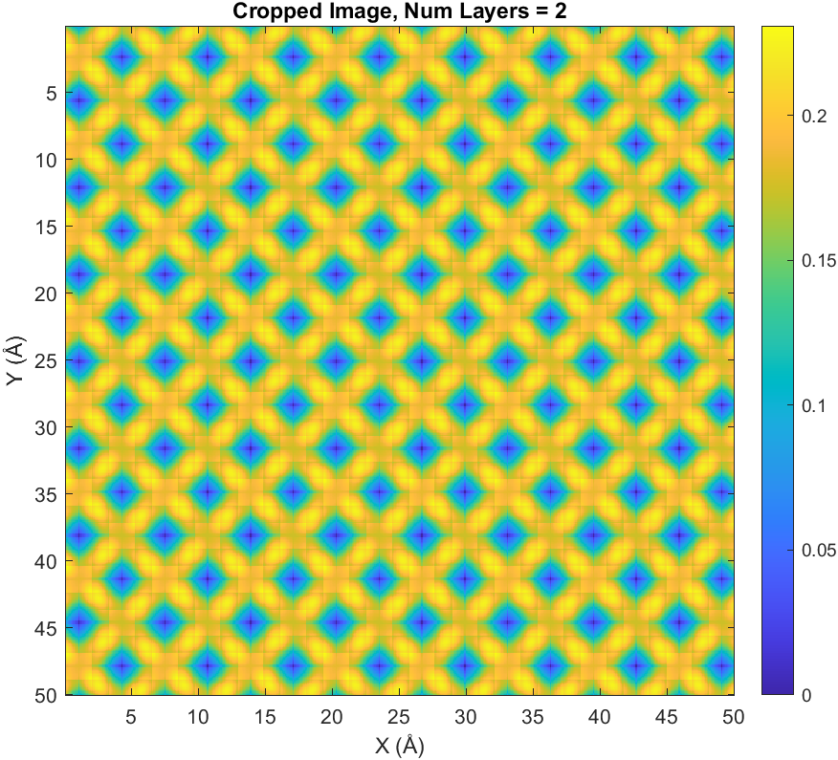

Num_layer=2, sigma= 5

Slide 9
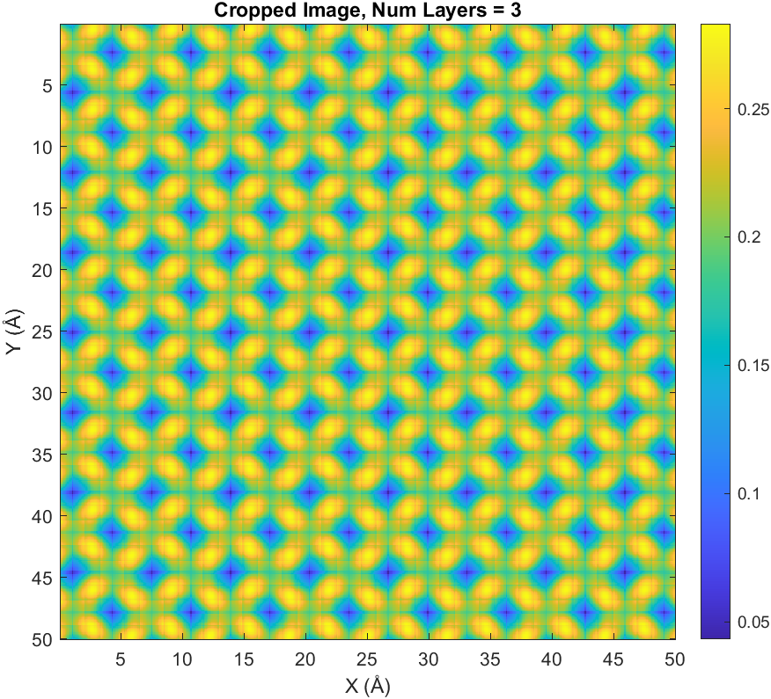

Num_layer=3, sigma= 5

Slide 10
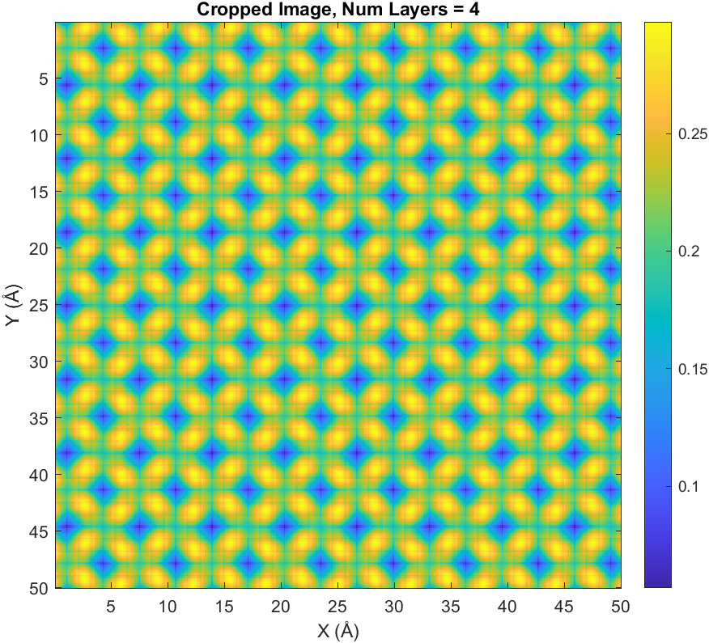

Num_layer=4, sigma= 5

